Slide 1
Fungal Infections
Dr. Patrick W. Narkwa
Dept. of Clinical Microbiology
School of Medical Sciences
KNUST

Slide 2
Learning Objectives
On completion of this session you should have an understanding of:
    The etiology of superficial, cutaneous, subcutaneous and systemic mycoses
    Clinical manifestations of superficial, cutaneous, subcutaneous and systemic mycoses
    Laboratory diagnosis of superficial, cutaneous, subcutaneous and systemic mycoses
    Treatment of superficial, cutaneous, subcutaneous and systemic mycoses

Slide 3
Fungal biology
Eukaryotes, non-motile and aerobic
Reproduction: sexual and asexual
    Fungi Imperfecti: Fungi that do not produce sexual spores
Saprophytic or parasitic
Rigid cell wall contains chitin, mannan and beta-glucan
  beta-glucan is the target of antifungal drug caspofungin
Cell membrane contains ergosterol (human cell membrane contains cholesterol)

Slide 4
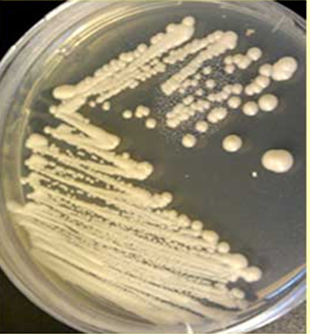
Fungal Morphology
Based on morphology fungi can be classified as yeast, moulds, and dimorphic fungi
  Yeasts: unicellular, round/oval, uninucleate, reproduce by asexual budding
    On culture medium, such as SDA (Sabouraud’s dextrose agar), they produce creamy mucoid colonies. Examples are Candida albicans and Cryptococcus neoformans

Slide 5

  Moulds: Grow as long filaments called hyphae (septate or non-septate). Hyphae on their continuous growth form mycelium
      The part of the mycelium that projects above the surface in culture medium is called aerial mycelium. Examples include Aspergillus, Penicillium, Rhizopus

Slide 6
Dimorphic fungi
  They exist as hyphal forms in the soil and in the cultures at 25°C
  They occur as yeasts in human tissue and in the cultures at 37°C
  Examples include Coccidioides immitis, Histoplasma capsulatum, Sporothrix schenckii etc.

Slide 7
Fungi vs. Bacteria
Feature | Fungi | Bacteria
Diameter Morphology Staining property Cell membrane Cell wall Spores Thermal dimorphism | App. 4µM Yeast and Mould Gram+, nonacid fast, stained with PAS & GMS Sterols present Chitin Sexual and asexual spores for reproduction Yes (seen in some fungi) | App. 1µM Cocci, bacilli, spirochete, branching Gram +/-, acid fast Sterols absent except mycoplasma Peptidoglycan Endospores for survival No
PAS: Periodic Acid-Schiff; GMS, Gomori’s Methenamine Silver

Slide 8
Laboratory Diagnosis
Specimens: from skin, nail, mucous membranes, scraping crusts, pus, blood, sputum as well as CSF may be taken
Direct microscopy
    10-30% KOH mount. KOH dissolves keratin and cellular elements leaving the alkali-resistant fungi intact
    India ink preparation of cerebrospinal fluid (CSF) is a useful method for demonstration of white capsule of C. neoformans in CSF
    Gram staining is also useful to demonstrate Gram-positive Candida species in the specimen
    microscopy: low sensitivity and requires an experienced microscopist for specific identification
Culture
  SDA, BHIA/Cornmeal agar, CHROM agar etc.
      Media with/without antibiotics, low pH (4-6) of the media + chloramphenicol & cycloheximide

Slide 9
Lab. diagnosis
Serological tests: ELISA
Antigen detection: Latex agglutination technique
  Molecular tests: PCR
Other tests
  Biochemical tests: Rapid kits for yeasts, Urease test
  Special tests: In vitro hair perforation test, Germ tube test

Slide 10
Antifungal agents and primary sites
of activity
Group of compounds | Antifungal agent | Mechanism of action
polyenes | Amphotericin B | Bind to ergosterol
Azole derivatives | Miconazole Ketoconazole Fluconazole itraconazole | Inhibit cytochrome P-450 dependent enzymes
Nucleoside analogs | 5-fluoro-cytosine | Inhibits DNA and RNA synthesis
Grisans | Griseofulvin | Inhibits microtubular function
Echinocandins | Caspofungin | B-1, 3 glucan synthetase inhibitors

Slide 11
Overview of Fungal Infections
Depending on the tissues that are initially colonized, fungal infections can be grouped into:
    Superficial mycoses
    Cutaneous mycoses
    Subcutaneous mycoses
    Systemic mycoses
      “True pathogens” – infect healthy hosts, although disease worsens with immunocompromised
      “Opportunists” – disease almost exclusively in immunocompromised

Slide 12
Superficial Mycoses
Infections limited to the outermost layer of skin and hair:
  No living tissue is invaded
  No cellular response from the host
  Causes cosmetic problems
Common infections:
  Tinea (Pityriasis) versicolor
  Tinea nigra
  Black piedra
  White piedra

Slide 13
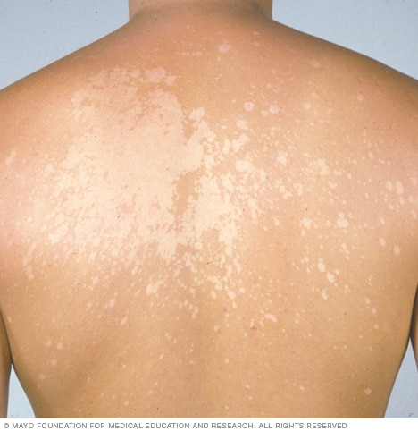
Tinea (Pityriasis) versicolor
Causative agent:
  Malassezia furfur
      Lipophilic yeast
Itch, affected skin changes colour and become either lighter or darker than surrounding skin
NOT CONTAGIOUS

Slide 14
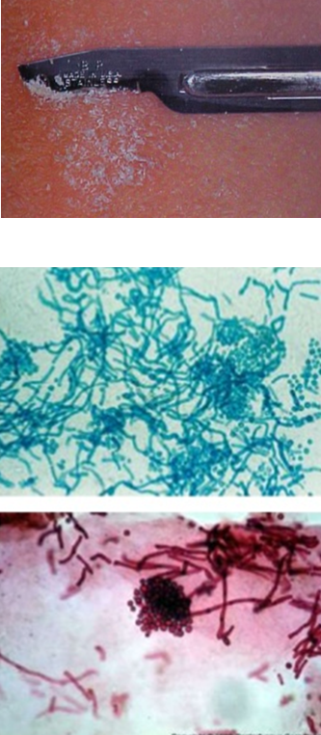
Diagnosis
Lab:
  10% KOH of skin scrapings
    Clusters of budding yeast cells & short hyphal forms (spaghetti-hyphae and meatballs-yeasts)
  Culture : rarely done
    SDA (Lipophilic yeast flood with Olive oil)

Slide 15
Treatment
Topical selenium sulphide shampoo
Imidazole ointment
Miconazole and Clotrimazole shampoo

Slide 16
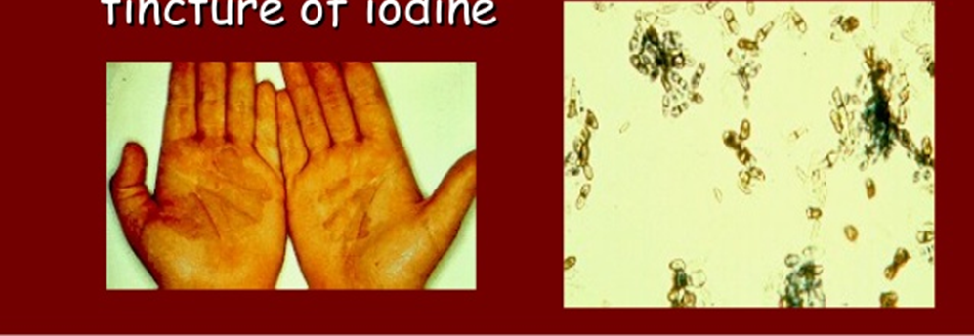
Tinea nigra
Causative agent: Exophiala (Hortae) werneckii (dimorphic fungus)
    produces melanin
Brown to black macular lesions often on palms and soles

Slide 17
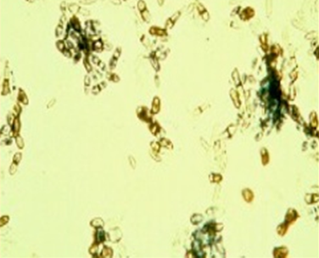
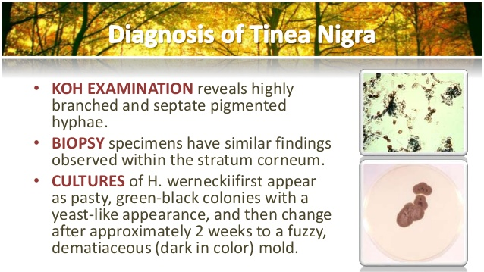
Lab Diagnosis
10% KOH
  Reveals highly branched and septate pigmented hyphae
  Microscopic examination of skin scraping: septate hyphae and yeast cells (brown in colour)
Culture
  Primary isolation media: SDA
    Initially mucoid, yeast-like & shiny black colonies
    With age: aerial mycelia & dark olive colour

Slide 18
Treatment
Topical salicylic acid
Tincture of iodine
Sulphur ointment
Imidazole & Triazole
Terbinafine

Slide 19
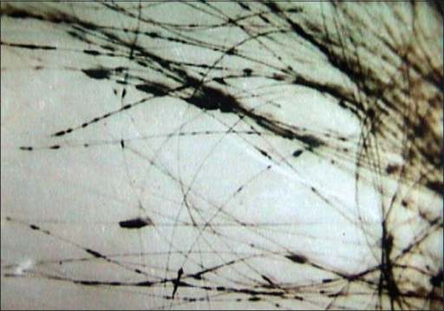
Black Piedra
Infection of shaft of hairs of beard and scalp
Causative agent: Piedraia hortae
Dark gritty deposits on hair
Treatment
  Hair cut
  Proper and regular washing
  Topical salicylic acid, azol creams

Slide 20
Lab. diagnosis
Direct microscopy
  Specimen-hair with nodules
  10 % KOH
  Dark septate hyphae
Culture
  SDA with chloramphenicol
  SDA ± cycloheximide
  Colonies are dark, brown-black

Slide 21
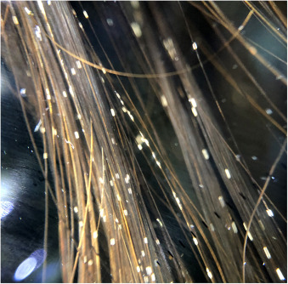
White Piedra
Causative agent: Trichosporon beigelii (yeast)
Soft whitish granules along hair shaft
Treatment
  Shaving of infected hairs
  Improve hygiene
  Topical azoles

Slide 22
Lab. diagnosis
Direct microscopy:
  Specimen-hair with nodules
  10% KOH
  Hyaline septate hyphae
  Oval or rectangular arthroconidia
  Occasional blastoconidia
Culture:
  SDA with chloramphenicol without cycloheximide
  White or yellowish to deep cream coloured colonies

Slide 23
Cutaneous Mycoses
Dermatophytoses: diseases of the skin, hair, and nail
Dermatophytes:
  Moulds producing keratinase
Three genera of dermatophyte fungi cause Tinea (ringworms)
  Microsporum: skin and hair
  Trichophyton: skin, hair and nail infections
  Epidermophyton: skin and nails
    Infections are transmitted by direct contact or contact with infected hair (hair salon) or cells (nail files, shower floors)

Slide 24
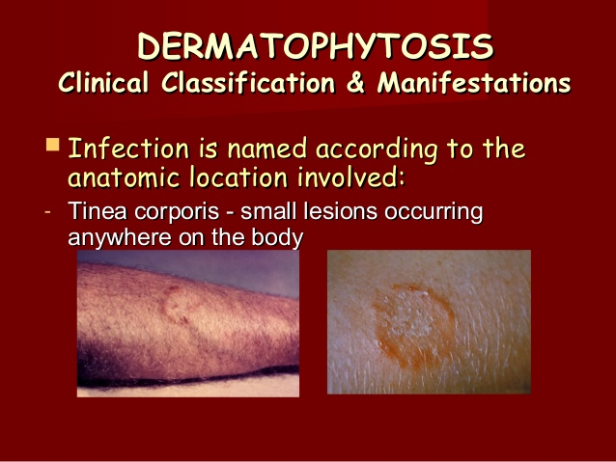
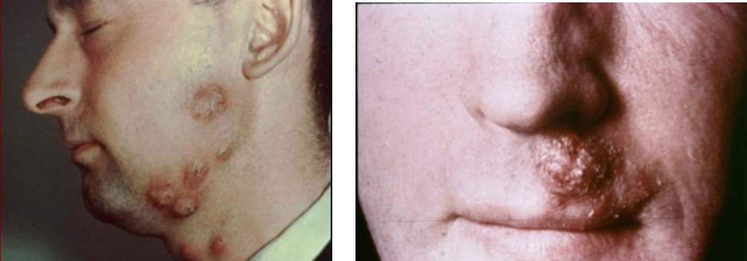
Clinical Manifestations
Named on the basis of location of infection sites:
Tinea corporis
Tinea barbae
  Ringworm infection (small lesions) occurring anywhere on the body (smooth or non hairy skin)
  Ringworm infection of the beard areas of the face and neck

Slide 25
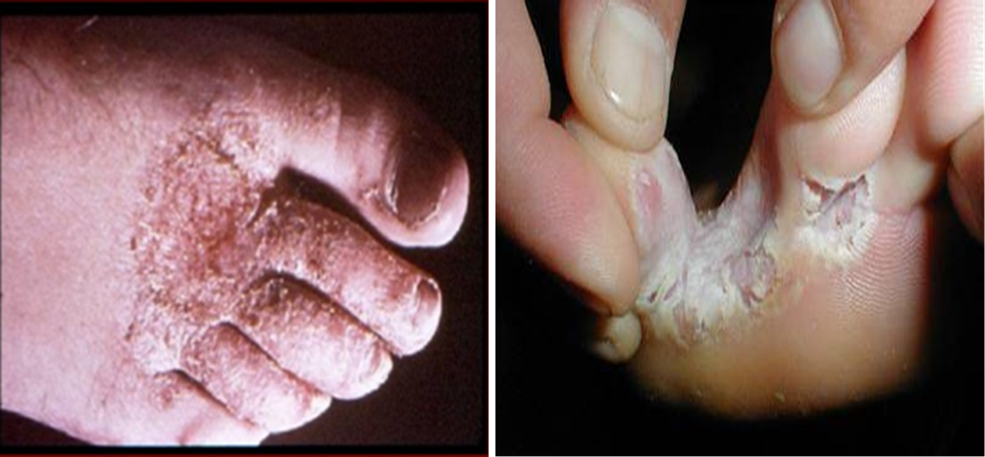
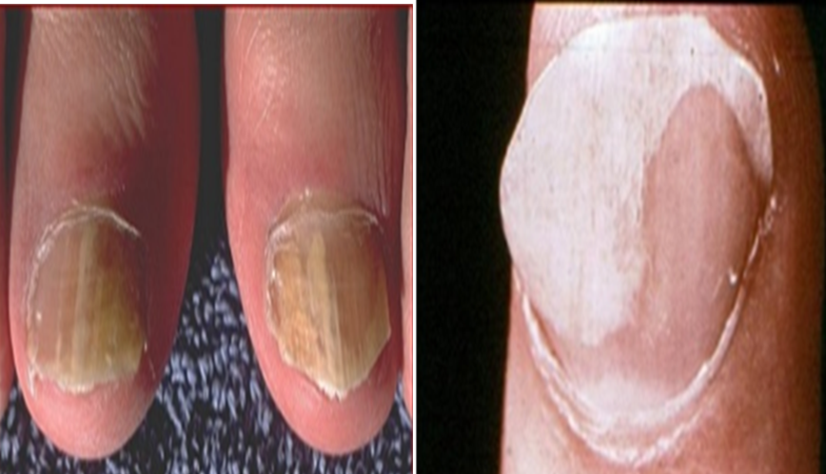
Tinea pedis
  Ringworm infection of toe webs and soles of feet (“athlete's foot”)
Tinea unguium
  Ringworm infection of the nails. Clipped and used for culture

Slide 26
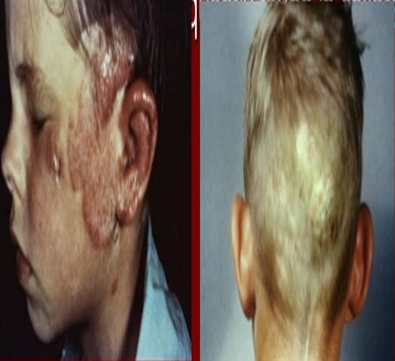
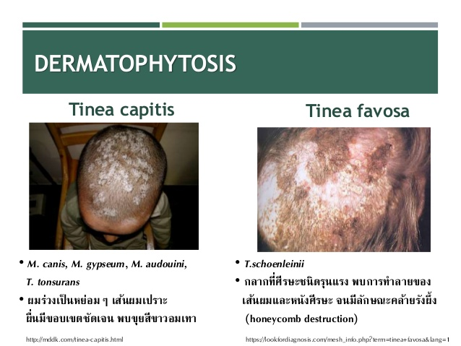
Tinea capitis
  Ringworm infection of the hair, scalp, eyebrows, eyelashes
  Frequently found in children
Tinea favosa
Ringworm infection of scalp. It leads to alopecia and scarring. It is the most severe form capitis

Slide 27
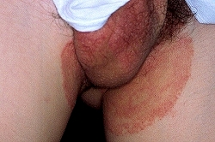
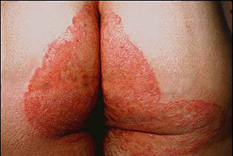
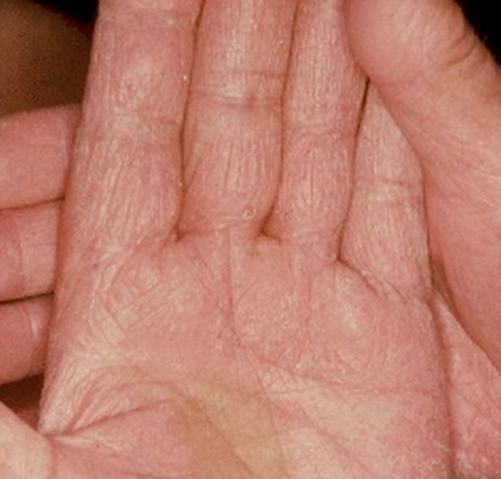
Tinea cruris
Ringworm infection of the groin (jock itch)
Tinea manuum
Ringworm infection of the hand

Slide 28
Lab. Diagnosis
Specimen: skin scrapings and nail clippings or hair taken from affected areas
Specimens are treated with 10-25% KOH with gentle warming
Direct microscopy is useful only for diagnosis while culture is done to identify the specific causative fungal agent
  Fungal hyphae

Slide 29
Lab. Diagnosis
Culture
  SDA- cycloheximide
    Trichophyton-Produces colonies that are powdery, velvety, waxy with pigment characteristics
    Microsporum: Produces velvety or powdery colonies with white-brown pigment
    Epidermophyton: produces powdery and greenish yellow colonies
Other test
  Hair perforation test/ in vitro hair perforation test is used to distinguish isolates of dermatophytes

Slide 30
Treatment
Treatment of dermatophyte infection is carried out by use of local antifungal drugs, such as miconazole, clotrimazole, econazole, etc., or by treatment orally with griseofulvin

Slide 31
Subcutaneous Mycoses
Infections of the dermis, subcutaneous tissue, muscle, and fascia
Pathogenesis
  Introduced through skin, grow in subcutaneous tissues, spread via lymphatics
  May reach distant organs especially bone, joints in path
Most common in non-industrialized world (“Madura foot”)

Slide 32
Subcutaneous: sporotrichosis
Causative agent: Sporothrix schenkii
  Dimorphic soil organism
  Worldwide distribution
Pathogenesis: splinters or thorns inoculate organism into subcutaneous tissues

Slide 33
Systemic Mycoses
the “opportunists”
Cause systemic infection in immune-compromised or sick people
Examples of immune compromised conditions include AIDS, alteration of normal flora by antibiotics, immunosuppressive therapy and metastatic cancer, diabetes, advanced age and malnutrition
The most common infections are: Candidiasis, Aspergillosis, Cryptococcosis, Mucormycosis etc.

Slide 34
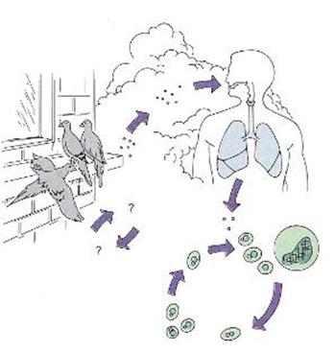
Cryptococcosis
Causative agent: Cryptococcus neoformans
  yeast with thick polysaccharide capsule
Habitat:
  soil and bird-pigeon droppings, worldwide
Pathogenesis: inhalation of yeast
Primary infection in lungs: Cryptococcal meningitis is most common disseminated manifestation
Can spread to skin, bone and prostate

Slide 35
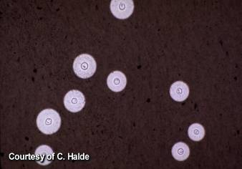
Lab. Diagnosis
Lumbar puncture and microscopic examination of CSF (India ink staining)
Cryptococcal antigens in CSF and serum
Culture: SDA- mucoid, cream coloured colonies
Molecular methods: PCR
Therapy
Amphotericin B & 5FC
Fluconazole also effective

Slide 36
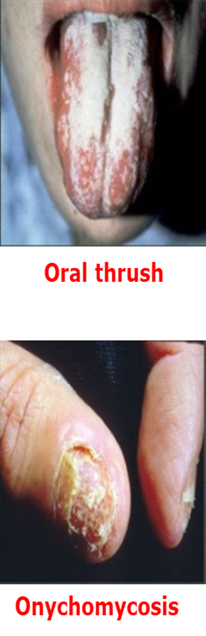
Candidiasis
Causative agent(s): Candida albicans et al
Habitat: normal human flora
Pathogenesis:
  colonized areas: overgrowth
  non-colonized areas: invasion
Symptoms: depend on area affected, some common symptoms are redness, itching, discomfort etc.

Slide 37
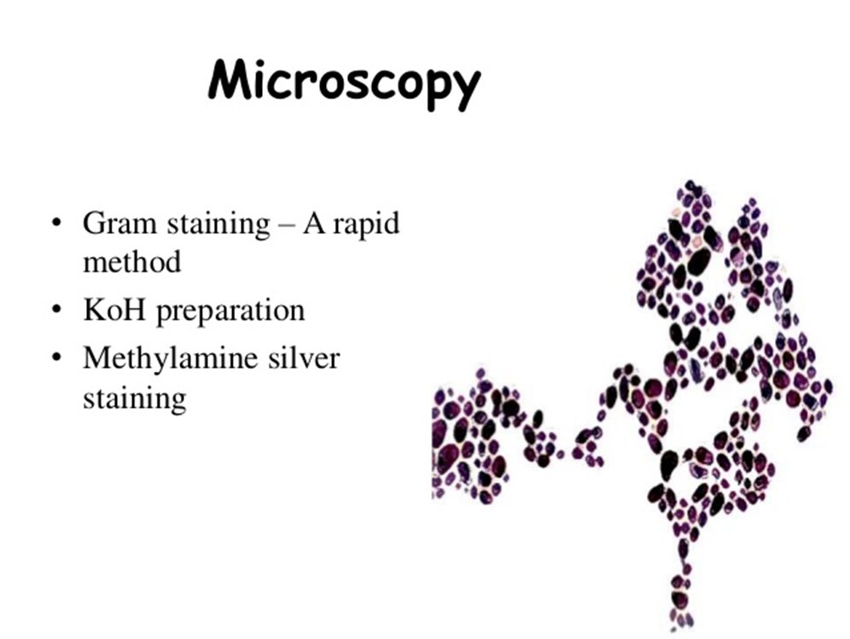
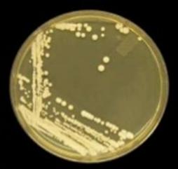
Lab. Diagnosis
Specimens: Skin scrapings, vaginal secretions, blood and other body fluids
Microscopy: KOH (10%) preparation, Gram staining
Culture: SDA and incubate at 25°C & 37°C, colonies are cream coloured, smooth & pasty
Serological reactions
  Ag detection (ELISA, RIA)
  Ab detection (IF, ELISA)
Molecular methods: PCR

Slide 38
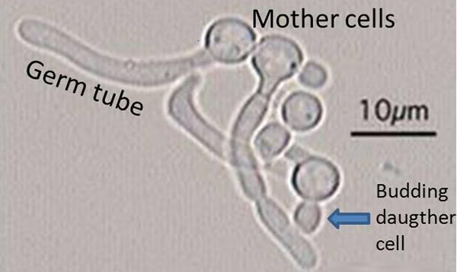
Identification of species as C. albicans
Germ tube test: inoculate yeast in human serum, incubate at 37°C for 2 to 4 hours

Slide 39
Aspergillosis
Causative agents: Aspergillus fumigatus and others
  Mold without a yeast phase
Habitat: everywhere, worldwide
Pathogenesis: Inhalation of spores
Symptoms: superficial lesions, coughing up of blood, chest pain, pneumonia etc.
Treatment: Voriconazole, Liposomal amphotericin B

Slide 40
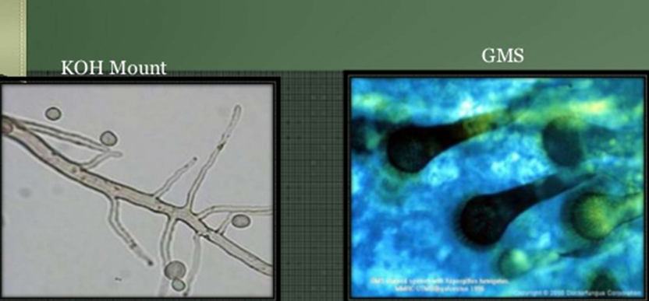
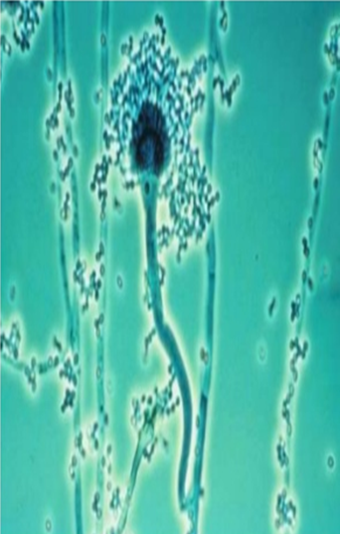
Lab. Diagnosis
KOH Mount
Specimens: sputum, transbronchial biopsy, pus, skin biopsy
Microscopy: KOH prep-hyaline septate hyphae with dichotomous branching
Histopathological section: PAS,GMS stain
Culture: Cultured as mycelial fungus, septate hyphae bearing spores
Ag-Ab. Detection: Latex agglutination, ELISA
Molecular detection: PCR

Slide 41
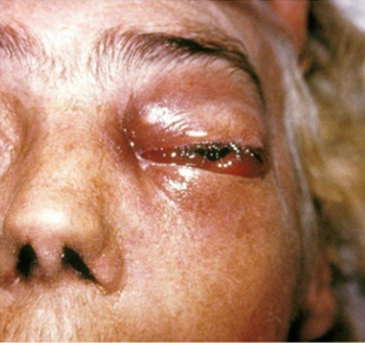
Mucormycosis
Causative agents: Rhizopus, Mucor, Absidia
  Mold without a yeast phase
Habitat: Everywhere, worldwide
Pathogenesis: Inhalation of spores
Symptoms: Facial swelling, bulging eye, headache, blurred & double vision, bleeding from nose etc.
Treatment: Amphotericin B, Fungizone

Slide 42
Lab. Diagnosis
Specimens: nasal discharge, pus, sputum, biopsy
Microscopy: KOH prep & biopsy with H & E, broad, aseptate, ribbon like hyphae, GMS-more sensitive
Culture: SDA-Mucor (grey brown); Rhizopus (light to dark grey);Absidia-white to pale grey
Antibody detection: there is no method of antibody-based diagnosis

Slide 43
Systemic Mycoses the “true pathogens”
Dimorphic
Respiratory acquisition
Restricted geographic distribution-Americas
Infect normal hosts
Disease reminiscent of TB
Diseases: Histoplasmosis, Coccidioidomycosis Paracoccidioidomycosis and Blastomycosis

Slide 44
Histoplasmosis
Organism: Histoplasma capsulatum
  Dimorphic soil organism
Habitat: soils with high nitrogen content
  Ohio-Mississippi valley; Puerto Rico, Central and S. America
  Guano of bats, birds, poultry (chicken coops and caves)
Pathogenesis: inhalation of spores

Slide 45
Coccioidomycosis
Organism: Coccoides immitis
  Dimorphic soil organism with spherules and endospores in host
Habitat: the lower Sonoran life zone (arid)
  Southwest US, Mexico, Central and South America
Pathogenesis: inhalation of spores

Slide 46
Blastomycosis
Organism: Blastomyces dermatitidis
  Dimorphic soil organism
Habitat: humid woodlands
  MidAtlantic countryside
  Beaver dams, peanut farms
  Organic debris
Pathogenesis: inhalation of spores

Slide 47
The End!

